Slide 1


Real-Time Swiggy Vs Zomato Analytics with Power BI
Presented by : Dhruvisha Bhaliya

Slide 2
What is Power BI
Power BI is an interactive data visualization software product.
Developed by Microsoft with a primary focus on business intelligence. Is is part of the Microsoft Power Platform.
It is a Business Intelligence tool which will help you to Analyse your data to Clean your data and Convert your data into visual format.
Power BI is a collection of components.
Example:- Power Query,Power Pivot,Power View,Power BI Desktop,Power BI Gateway,Power BI Mobile Apps and Power BI Service.

Slide 3
INTRODUCTION
This project analyzes Swiggy's sales, user behavior, and market trends using Power BI. It provides real-time insights into key metrics such as orders, revenue, customer demographics, and city-wise performance.
Visualizes sales trends, user behavior, and business insights using interactive charts and filters.
Helps in data-driven decision-making, identifying trends, and improving marketing strategies.
Order details, user demographics, sales, ratings, and city-wise performance.
Swiggy vs Zomato comparison

Slide 4
Problem Statement
In the highly competitive online food delivery industry, platforms like Swiggy and Zomato need deep insights into customer behavior, city-level performance, and market trends. However, the absence of a unified analytical view creates challenges in:
Understanding gender-based user preferences
Analyzing city-wise sales, ratings, and user counts
Comparing Swiggy vs Zomato on key performance metrics
Identifying top-performing restaurants and cuisines
Making informed, data-driven business decisions

Slide 5
Swiggy Data Model & Relationships
Users Table – Contains customer demographics (age, gender, occupation, etc.).
Orders Table – Stores transaction data like order date, city, currency and user ID.
Restaurant Table – Holds details about restaurant locations, ratings.
Menu Table – Lists menu items along with prices and food types.
Food Table – Stores food-specific data, linking to the menu.

Slide 6
Scope & Objective
Compare Swiggy and Zomato on key metrics such as number of restaurants, votes, ratings, price ranges, and cuisine popularity.
Monitor city-wise performance by tracking top-performing cities based on sales, user count, and rating metrics, and visualizing them geographically.
Understand restaurant trends, highlighting top-rated and most-voted restaurants, cuisine types, and price vs. rating patterns for both platforms.
Use filters and slicers for gender, year, and city to drill down into targeted data insights, empowering data-driven decisions.

Slide 7
Technology Stack
Data Source & Storage:
Excel / CSV Files
Swiggy and Zomato datasets were imported in tabular format for processing.
Data Cleaning & Transformation:
Power Query
Used to clean, format, and transform raw data before loading into the Power BI model.
Data Analysis & Modeling:
DAX (Data Analysis Expressions)
For creating custom measures, KPIs, and calculated columns.
Data Model
Relationship modeling between tables for efficient filtering and analysis.

Slide 8
Features & Functionality
Dynamic Filters – Year, Gender, City, Amount, Quantity
Interactive Visuals – Auto-update charts (bar, line, pie, maps)
User Demographics – Gender-wise sales, age, occupation
City Insights – Ratings, sales, users shown city-wise
Cuisine & Restaurants – Top cuisines & restaurants by votes/ratings
Swiggy vs Zomato – Compare pricing, reviews, popularity

Slide 9
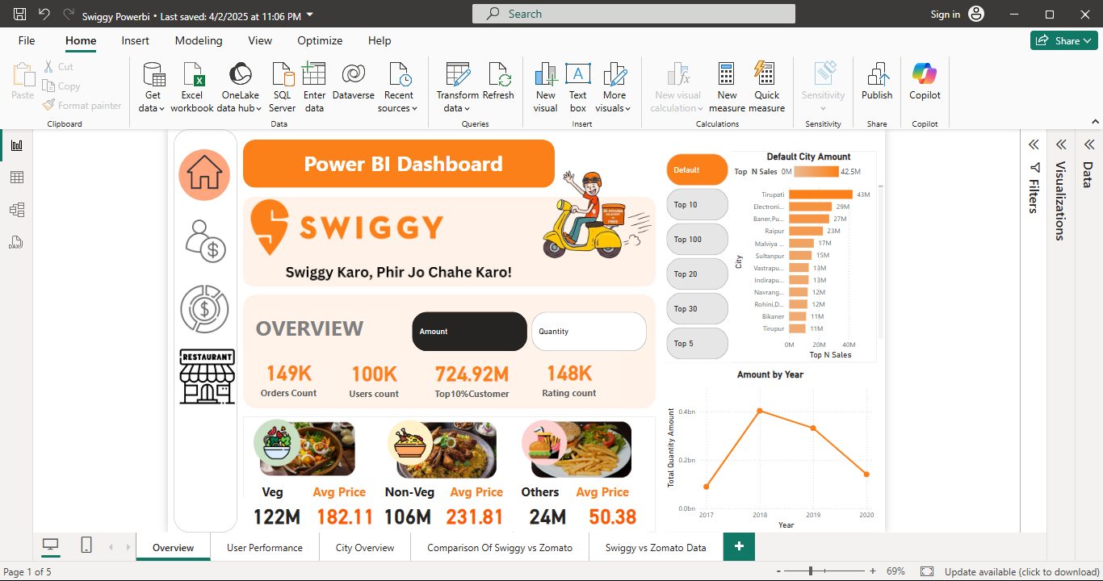

Slide 10
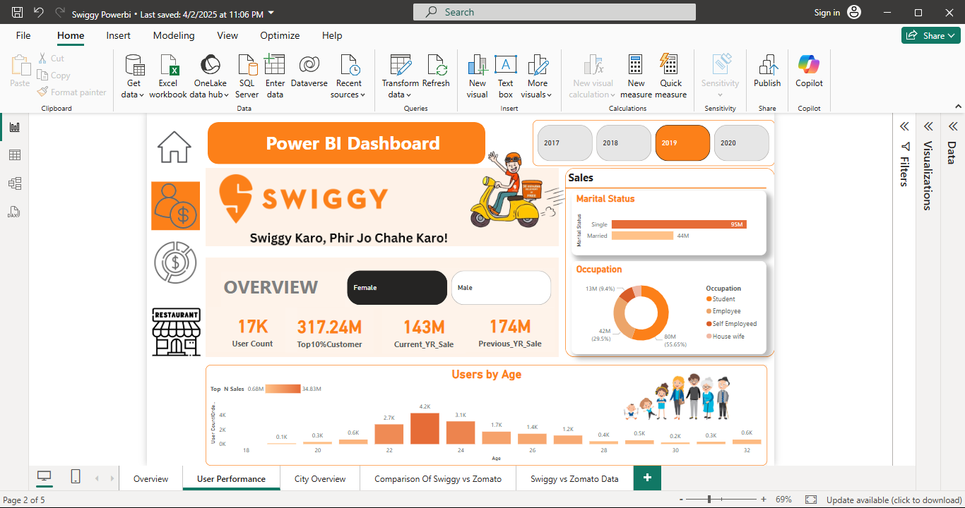

Slide 11
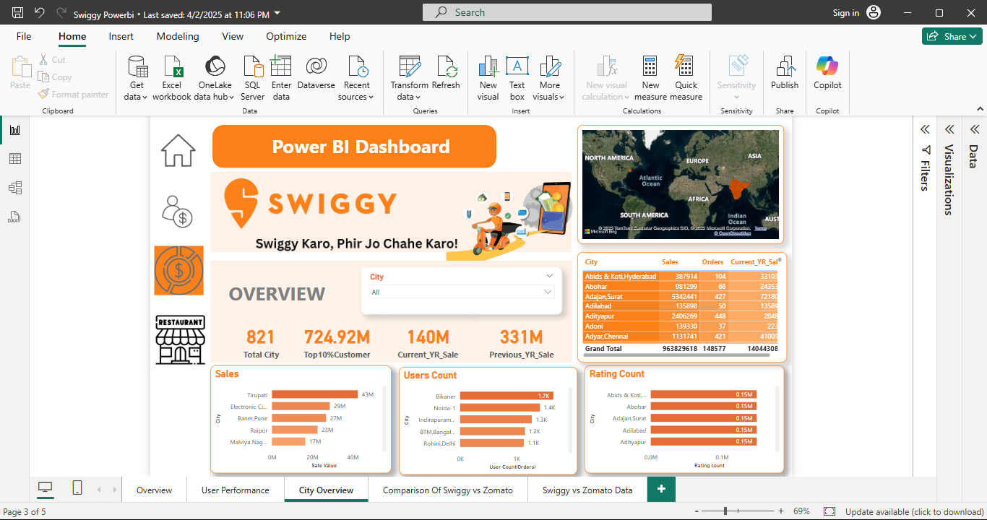

Slide 12
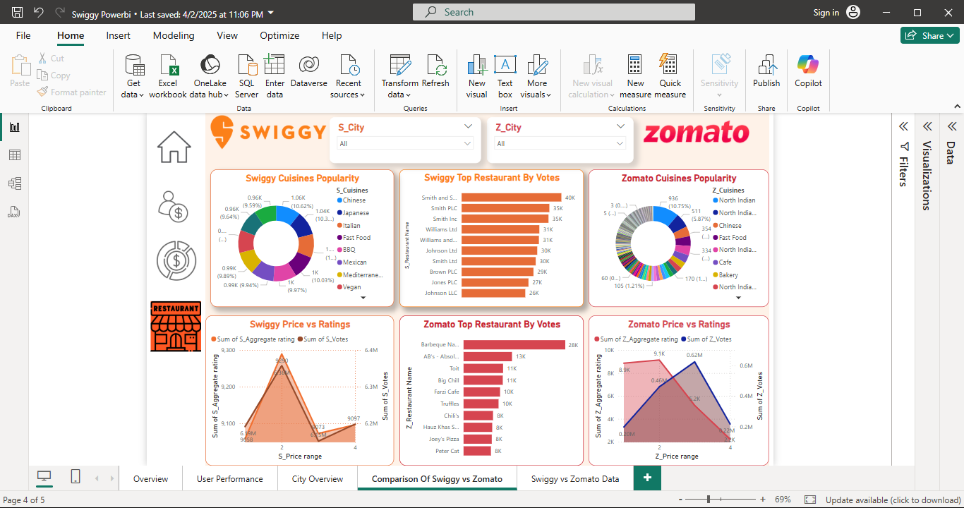

Slide 13
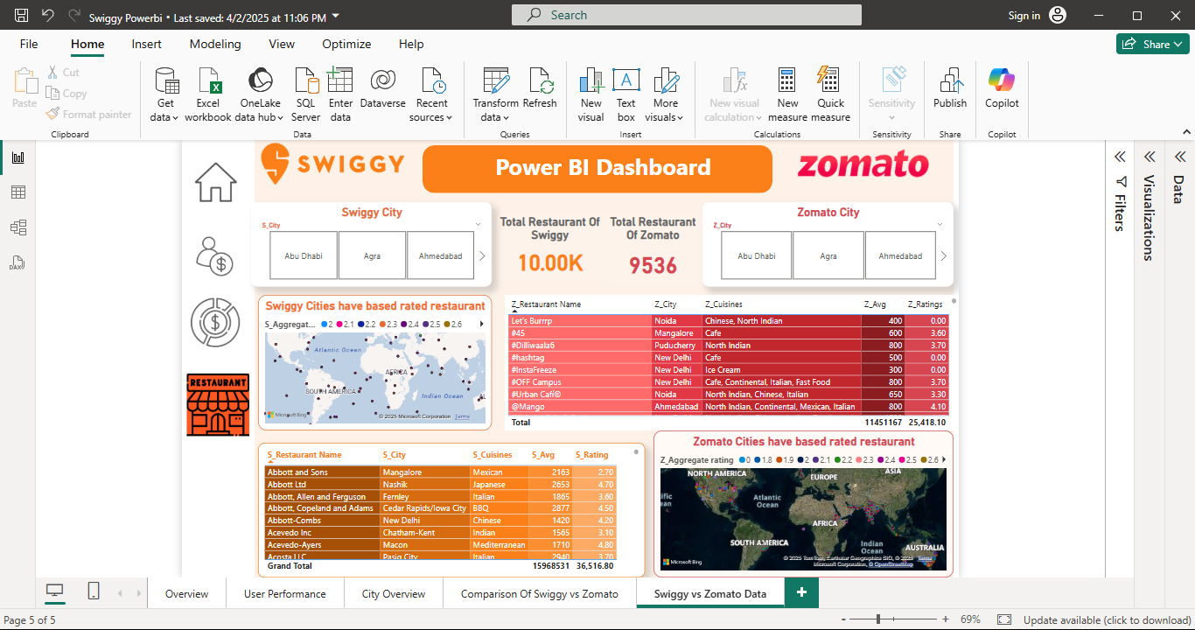

Slide 14
Challenges Faced & Solutions
Challenge | Solution Implemented
🔄 Handling large & unclean datasets | Used Power Query for data cleaning & transformation
🔍 Difficulty in relationship modeling | Built a star schema model with clear table links
📊 Overlapping visuals & clutter | Applied consistent layout & chart selection
🔁 Syncing multiple filters | Used slicers & interactions for dynamic updates
📈 Swiggy vs Zomato comparison complexity | Created separate measures for each platform
🌍 Mapping city data accurately | Used Bing Maps visual with cleaned location data

Slide 15


Operational Efficiency & Growth Strategy
Customer Loyalty Tracking : Top 10% of customers contribute significantly to sales.
Competitor Benchmarking : Direct comparison enables each platform to monitor market share and performance gaps for focused growth planning.

Slide 16
References & Learning Resources
Merge Query : https://learn.microsoft.com/en-us/power-query/merge-queries-overview
Data Table : https://learn.microsoft.com/en-us/dax/datatable-function-dax
Unpivot columns : https://support.microsoft.com/en-us/office/unpivot-columns-power-query-0f7bad4b-9ea1-49c1-9d95-f588221c7098

